Slide 1
2019-03-28

Slide 2
Support Vector Machines
参考资料：[Andrew Ng] CS229 Lecture notes 3

Slide 3
Support Vector Machines
SVMs are among the best (and many believe are indeed the best) “off-the-shelf” supervised learning algorithms.

Slide 4
Support Vector Machines
margins and the idea of separating data with a large “gap”
the optimal margin classifier, which will lead us into a digression on Lagrange duality
kernels, which give a way to apply SVMs efficiently in very high dimensional (such as infinitedimensional) feature spaces
SMO algorithm, which gives an efficient implementation of SVMs

Slide 5
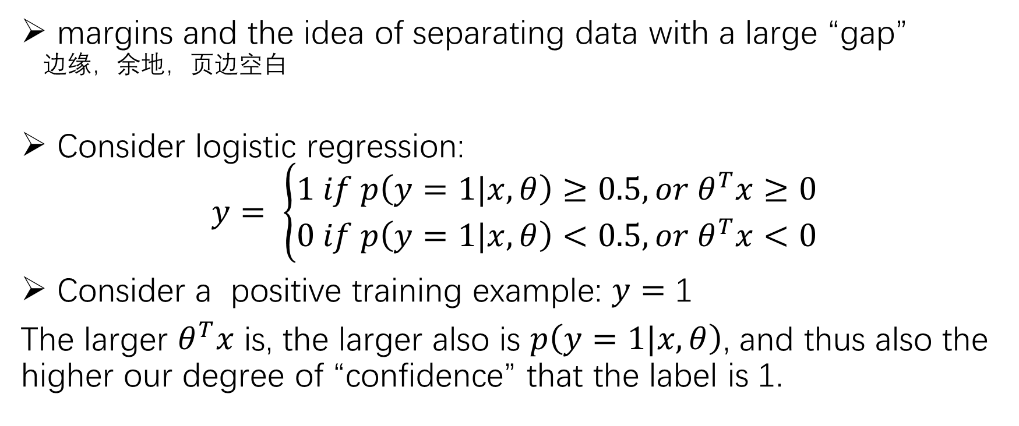
Support Vector Machines
margins and the idea of separating data with a large “gap” 边缘，余地，页边空白
Consider logistic regression:
$$y= \left\{\begin{aligned}1 if p\left(y=1|x, θ\right)≥0.5, or θ^{T}x≥0 \\ 0 if p\left(y=1|x, θ\right)<0.5, or θ^{T}x<0\end{aligned}\right.$$
Consider a positive training example: $y=$ 1
The larger $θ^{T}x$ is, the larger also is $p\left(y=1|x, θ\right)$, and thus also the higher our degree of “confidence” that the label is 1.

Slide 6
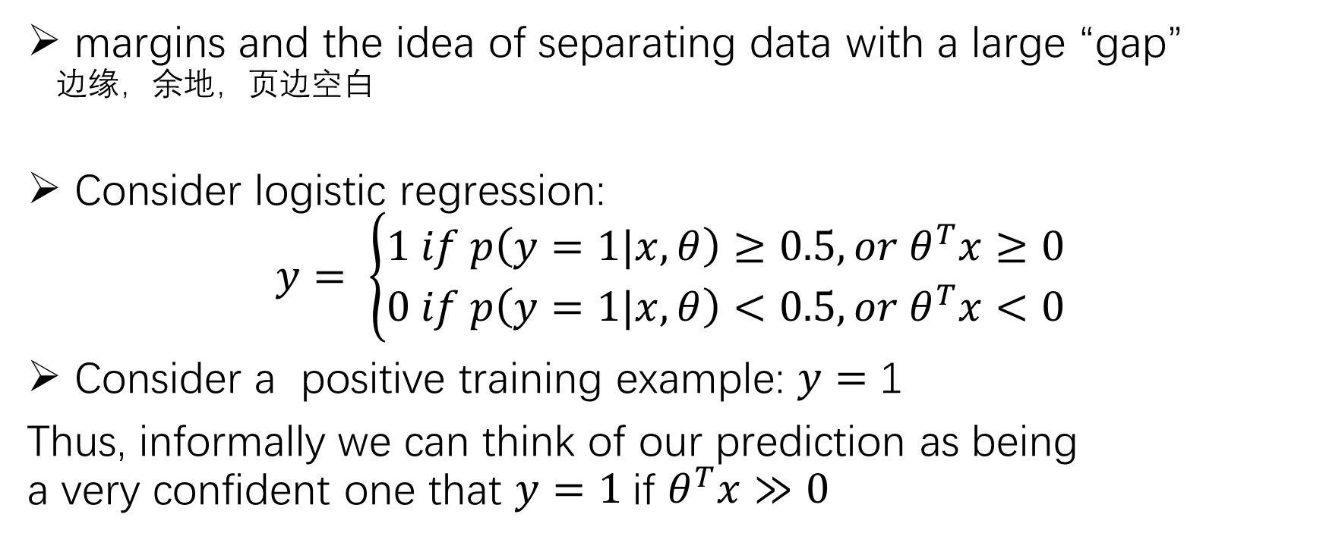
Support Vector Machines
margins and the idea of separating data with a large “gap” 边缘，余地，页边空白
Consider logistic regression:
$$y= \left\{\begin{aligned}1 if p\left(y=1|x, θ\right)≥0.5, or θ^{T}x≥0 \\ 0 if p\left(y=1|x, θ\right)<0.5, or θ^{T}x<0\end{aligned}\right.$$
Consider a positive training example: $y=$ 1
Thus, informally we can think of our prediction as being a very confident one that $y=1$if $θ^{T}x≫0$

Slide 7
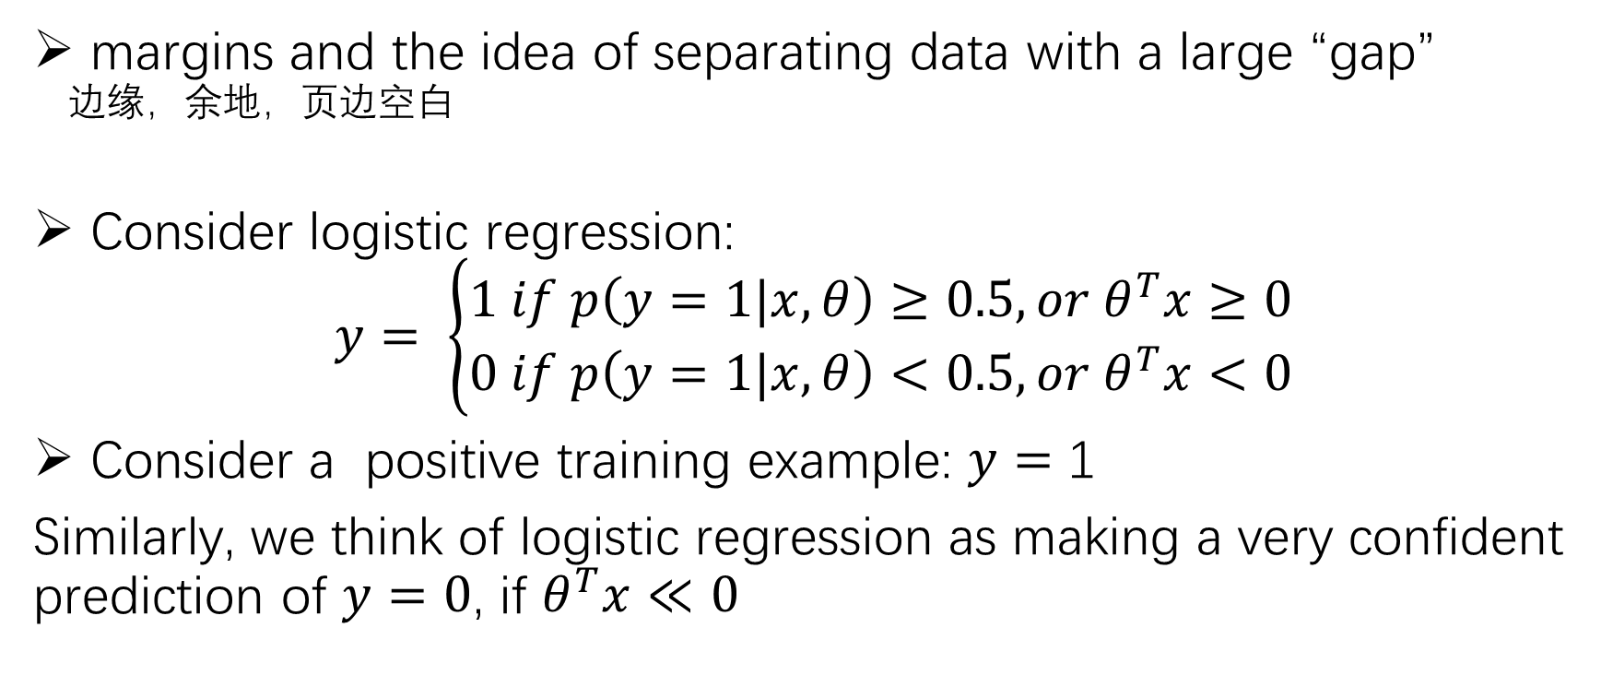
Support Vector Machines
margins and the idea of separating data with a large “gap” 边缘，余地，页边空白
Consider logistic regression:
$$y= \left\{\begin{aligned}1 if p\left(y=1|x, θ\right)≥0.5, or θ^{T}x≥0 \\ 0 if p\left(y=1|x, θ\right)<0.5, or θ^{T}x<0\end{aligned}\right.$$
Consider a positive training example: $y=$ 1
Similarly, we think of logistic regression as making a very confident prediction of $y=0$, if $θ^{T}x≪0$

Slide 8
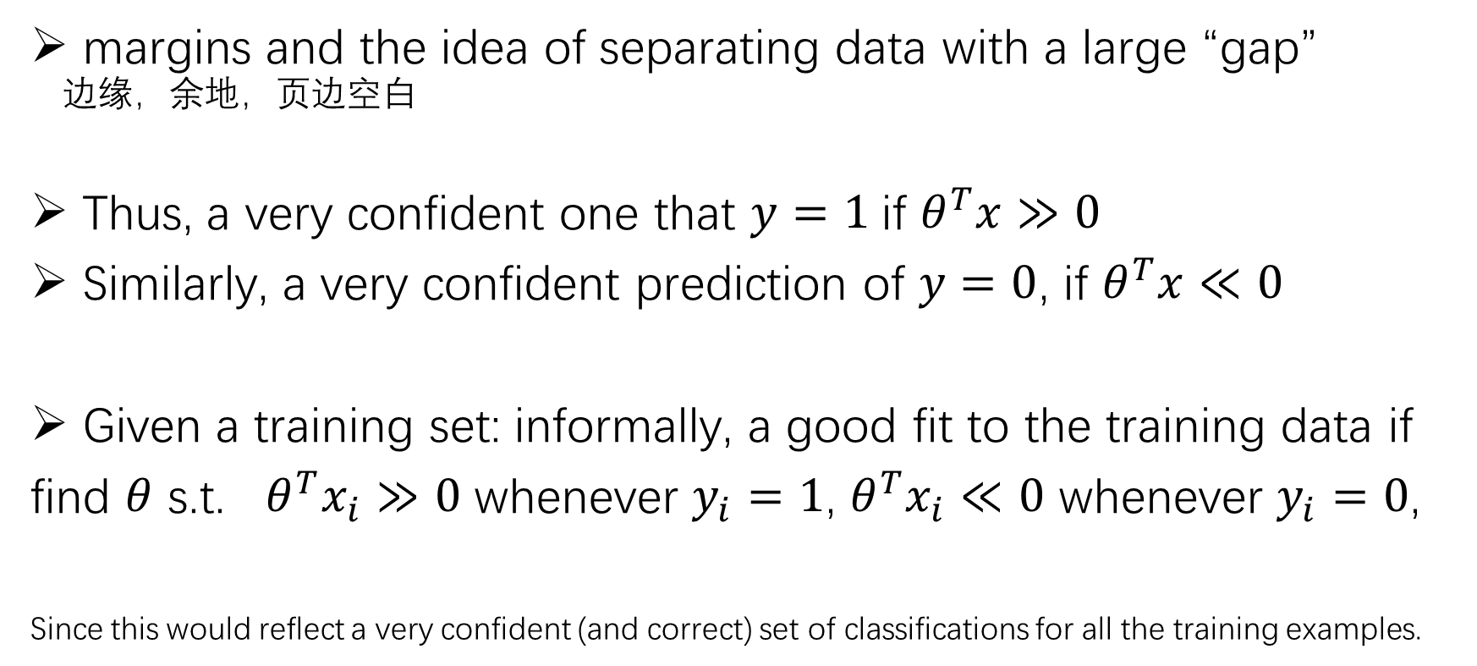
Support Vector Machines
margins and the idea of separating data with a large “gap” 边缘，余地，页边空白
Thus, a very confident one that $y=1$if $θ^{T}x≫0$
Similarly, a very confident prediction of $y=0$, if $θ^{T}x≪0$
Given a training set: informally, a good fit to the training data if
find $θ$ s.t. $θ^{T}x_{i}≫0$ whenever $y_{i}=1$, $θ^{T}x_{i}≪0$ whenever $y_{i}=0$,
Since this would reflect a very confident (and correct) set of classifications for all the training examples.

Slide 9
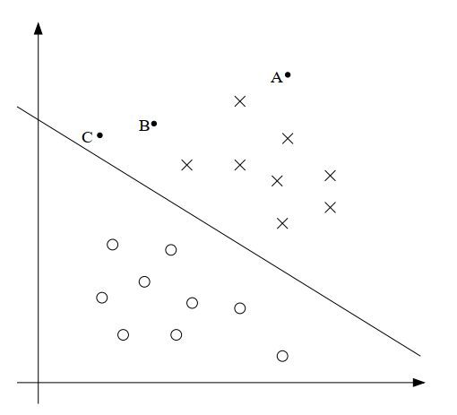
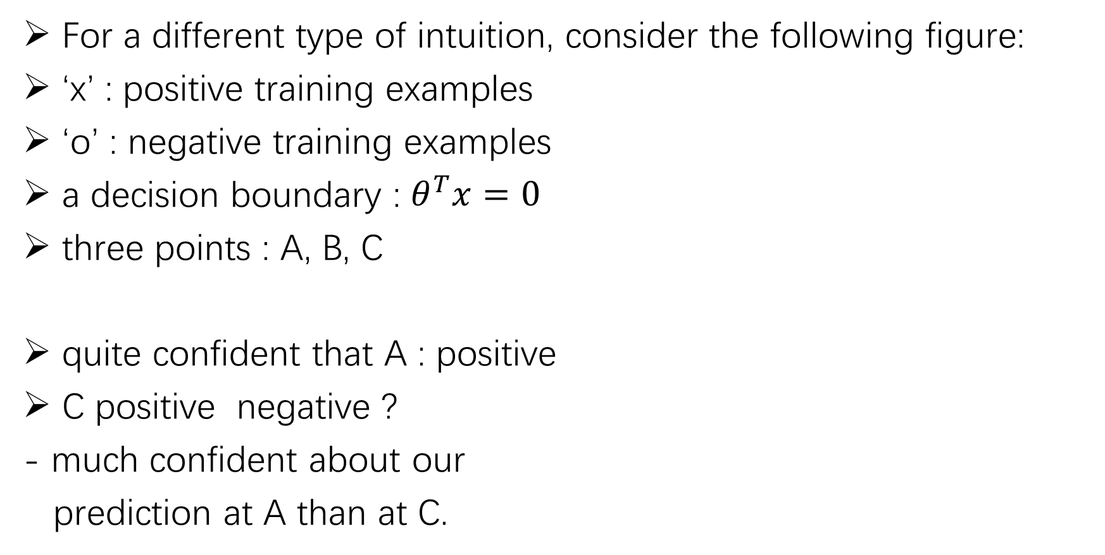
Support Vector Machines
For a different type of intuition, consider the following figure:
‘x’ : positive training examples
‘o’ : negative training examples
a decision boundary : $θ^{T}x=0$
three points : A, B, C
quite confident that A : positive
C positive negative ?
- much confident about our
prediction at A than at C.

Slide 10
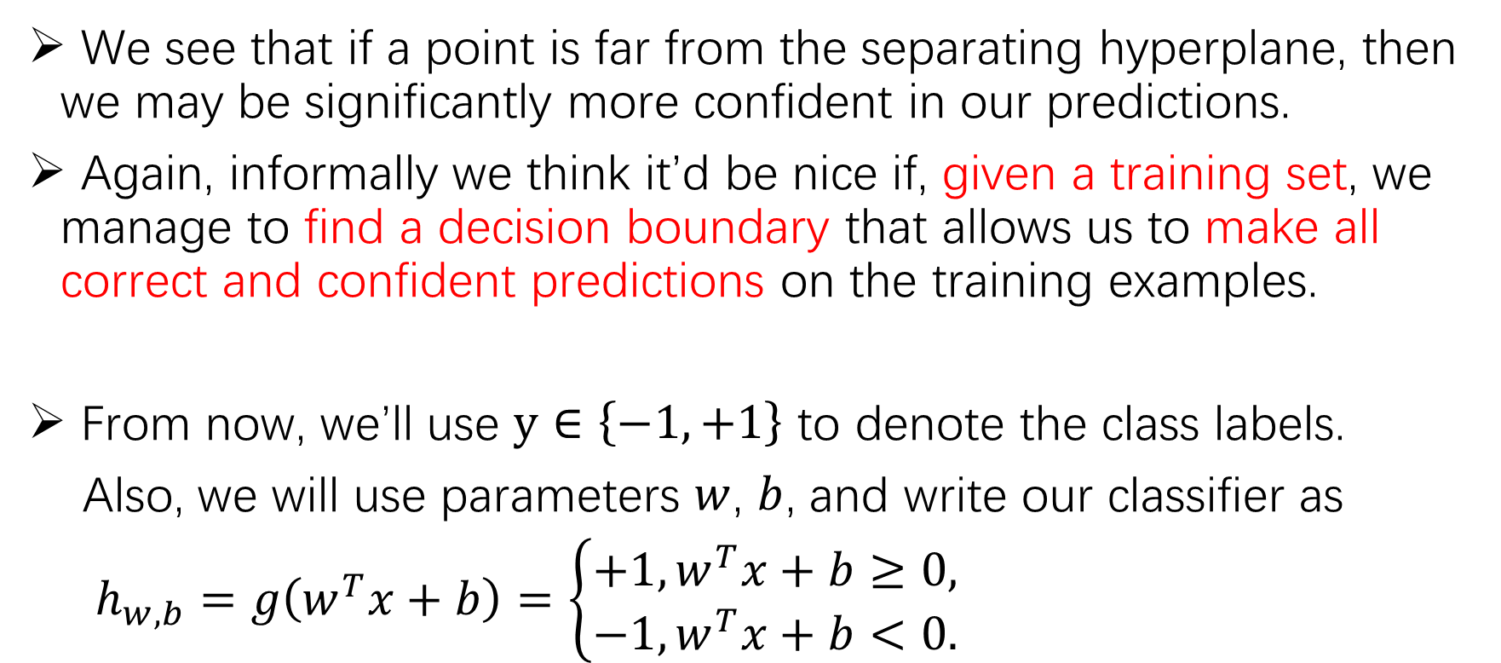
Support Vector Machines
We see that if a point is far from the separating hyperplane, then we may be significantly more confident in our predictions.
Again, informally we think it’d be nice if, given a training set, we manage to find a decision boundary that allows us to make all correct and confident predictions on the training examples.
From now, we’ll use $y∈\left\{−1, +1\right\}$ to denote the class labels.
Also, we will use parameters $w$, $b$, and write our classifier as
$h_{w,b}=g\left(w^{T}x+b\right)=\left\{\begin{aligned}+1, w^{T}x+b≥0, \\ −1,w^{T}x+b<0.\end{aligned}\right.$

Slide 11
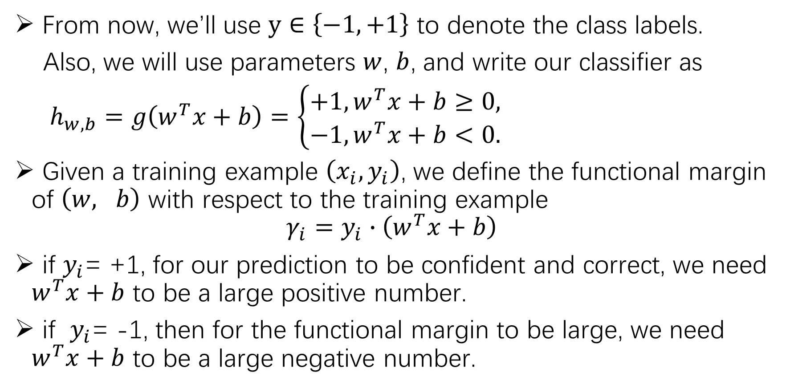
the functional and geometric margins
From now, we’ll use $y∈\left\{−1, +1\right\}$ to denote the class labels.
Also, we will use parameters $w$, $b$, and write our classifier as
$h_{w,b}=g\left(w^{T}x+b\right)=\left\{\begin{aligned}+1, w^{T}x+b≥0, \\ −1,w^{T}x+b<0.\end{aligned}\right.$
Given a training example $\left(x_{i},y_{i}\right)$, we define the functional margin of $\left(w, b\right)$ with respect to the training example
$$γ_{i}=y_{i}∙\left(w^{T}x+b\right)$$
if $y_{i}$= +1, for our prediction to be confident and correct, we need $w^{T}x+b$ to be a large positive number.
if $y_{i}$= -1, then for the functional margin to be large, we need $w^{T}x+b$ to be a large negative number.

Slide 12
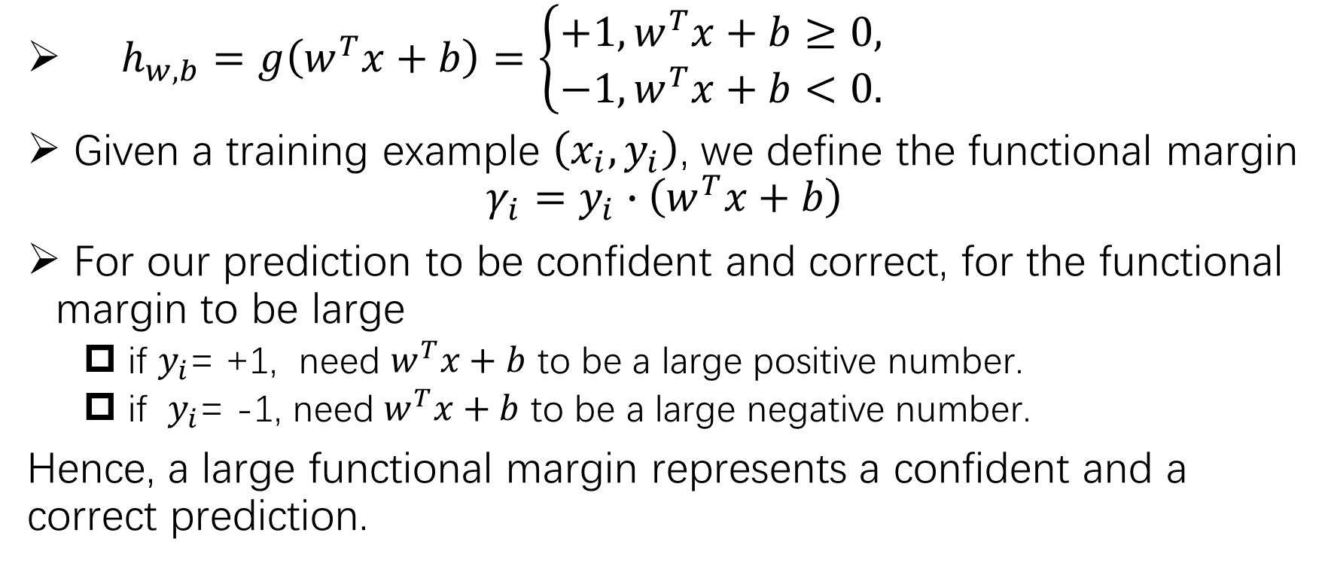
the functional and geometric margins
$h_{w,b}=g\left(w^{T}x+b\right)=\left\{\begin{aligned}+1, w^{T}x+b≥0, \\ −1,w^{T}x+b<0.\end{aligned}\right.$
Given a training example $\left(x_{i},y_{i}\right)$, we define the functional margin
$$γ_{i}=y_{i}∙\left(w^{T}x+b\right)$$
For our prediction to be confident and correct, for the functional margin to be large
if $y_{i}$= +1, need $w^{T}x+b$ to be a large positive number.
if $y_{i}$= -1, need $w^{T}x+b$ to be a large negative number.
Hence, a large functional margin represents a confident and a correct prediction.

Slide 13
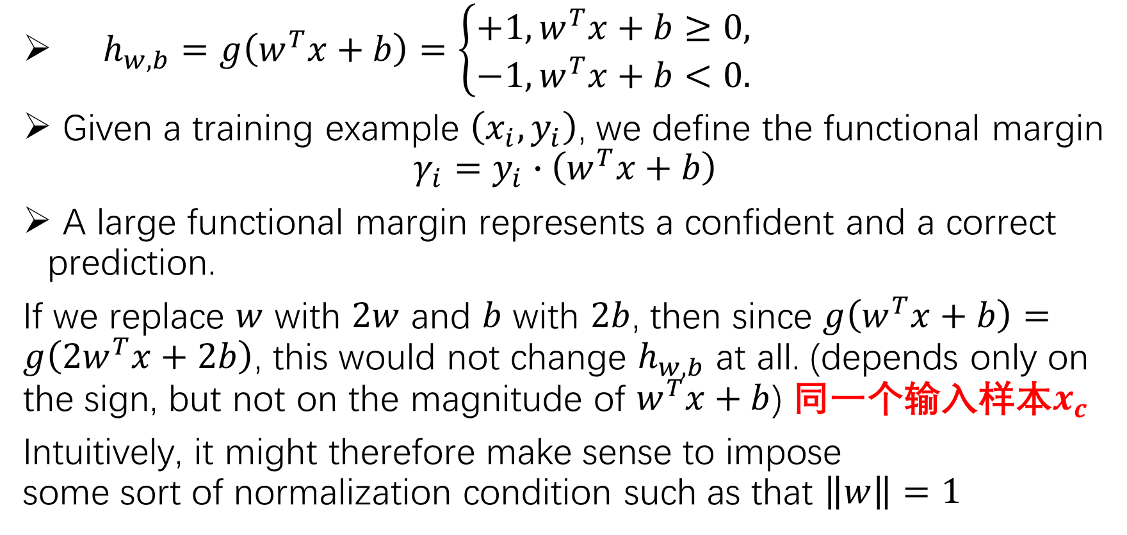
the functional and geometric margins
$h_{w,b}=g\left(w^{T}x+b\right)=\left\{\begin{aligned}+1, w^{T}x+b≥0, \\ −1,w^{T}x+b<0.\end{aligned}\right.$
Given a training example $\left(x_{i},y_{i}\right)$, we define the functional margin
$$γ_{i}=y_{i}∙\left(w^{T}x+b\right)$$
A large functional margin represents a confident and a correct prediction.
If we replace $w$ with $2w$ and $b$ with $2b$, then since $g\left(w^{T}x+b\right)=g\left(2w^{T}x+2b\right)$, this would not change $h_{w,b}$ at all. (depends only on the sign, but not on the magnitude of $w^{T}x+b$) 同一个输入样本$x_{c}$
Intuitively, it might therefore make sense to impose some sort of normalization condition such as that $\left\|w\right\|=1$

Slide 14
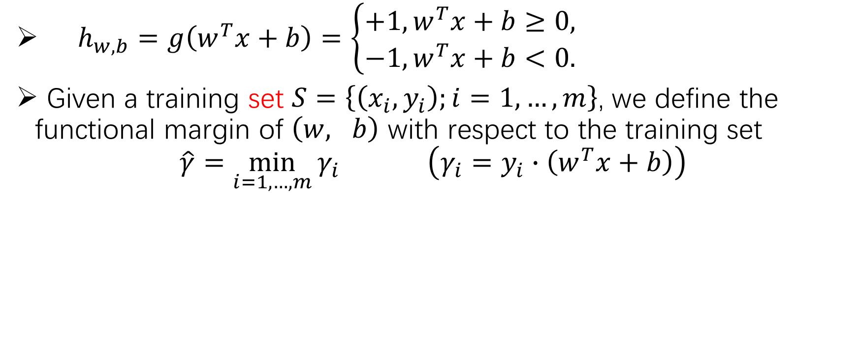
the functional and geometric margins
$h_{w,b}=g\left(w^{T}x+b\right)=\left\{\begin{aligned}+1, w^{T}x+b≥0, \\ −1,w^{T}x+b<0.\end{aligned}\right.$
Given a training set $S=\left\{\left(x_{i},y_{i}\right);i=1,…,m\right\}$, we define the functional margin of $\left(w, b\right)$ with respect to the training set
$$\hat{γ}=\min_{i=1,…,m}{γ_{i}} \left(γ_{i}=y_{i}∙\left(w^{T}x+b\right)\right)$$

Slide 15
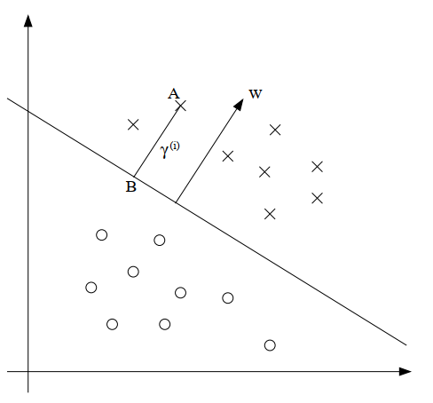
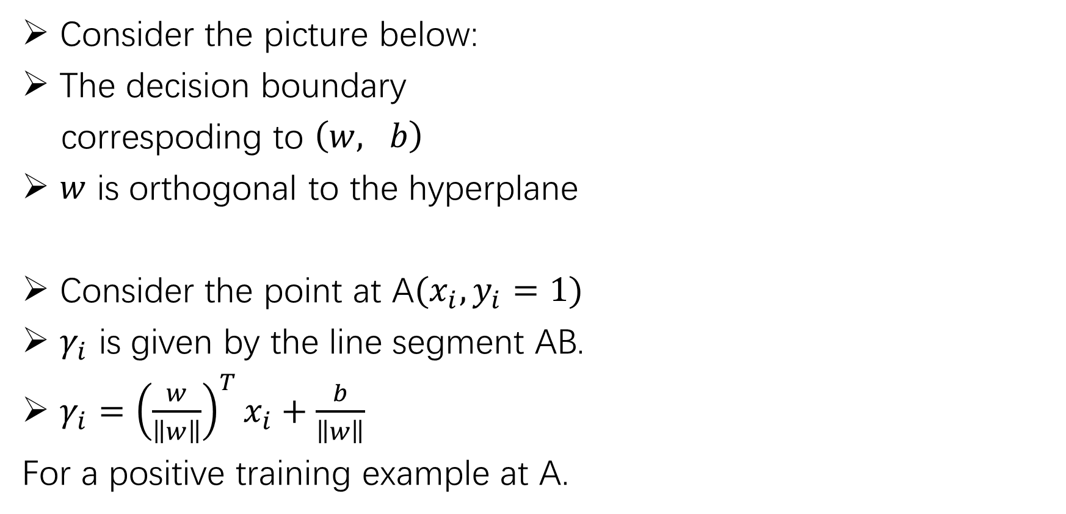
geometric margins
Consider the picture below:
The decision boundary
correspoding to $\left(w, b\right)$
$w$ is orthogonal to the hyperplane
Consider the point at A${(x}_{i},y_{i}=1)$
$γ_{i}$ is given by the line segment AB.
$γ_{i}={\left(\frac{w}{\left\|w\right\|}\right)}^{T}x_{i}+\frac{b}{\left\|w\right\|}$
For a positive training example at A.

Slide 16
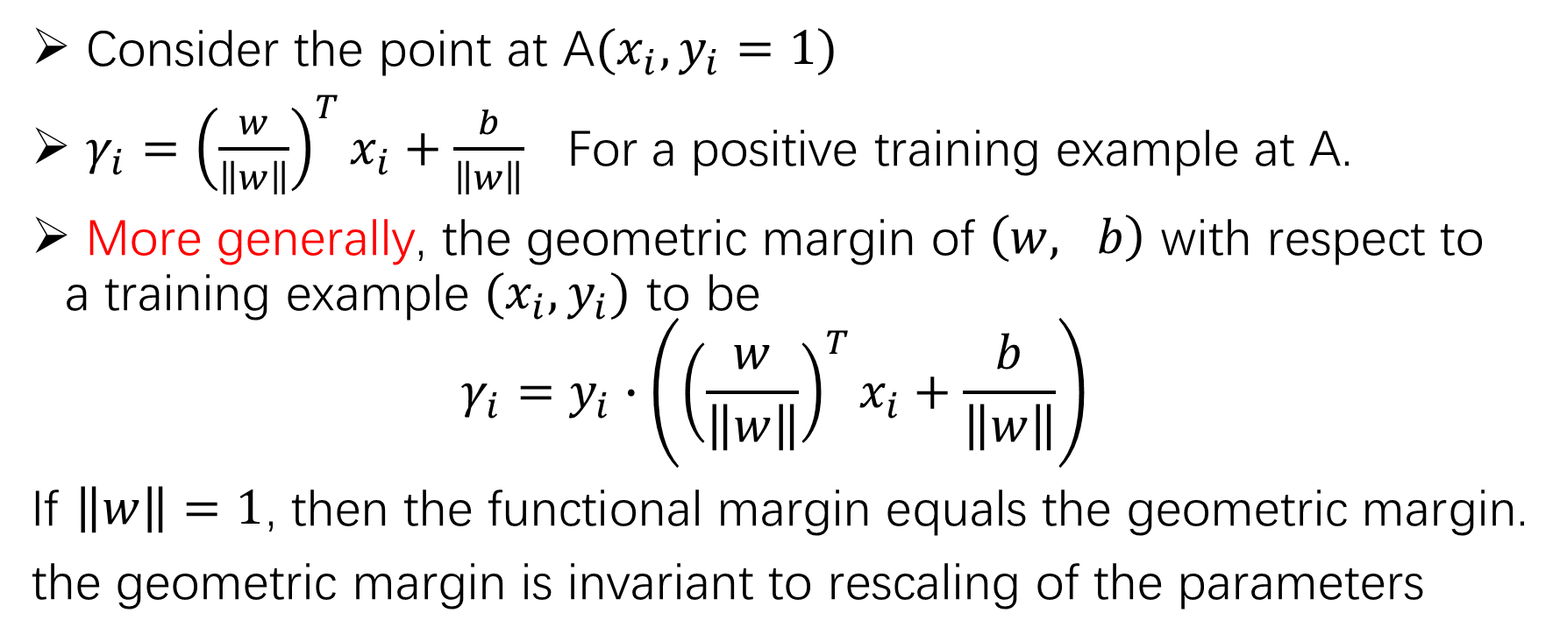
geometric margins
Consider the point at A${(x}_{i},y_{i}=1)$
$γ_{i}={\left(\frac{w}{\left\|w\right\|}\right)}^{T}x_{i}+\frac{b}{\left\|w\right\|}$ For a positive training example at A.
More generally, the geometric margin of $\left(w, b\right)$ with respect to a training example ${(x}_{i},y_{i})$ to be
$$γ_{i}=y_{i}∙\left({\left(\frac{w}{\left\|w\right\|}\right)}^{T}x_{i}+\frac{b}{\left\|w\right\|}\right)$$
If $\left\|w\right\|=1$, then the functional margin equals the geometric margin.
the geometric margin is invariant to rescaling of the parameters

Slide 17
The optimal margin classifier
Given a training set, it seems from our previous discussion that a natural desideratum is to try to find a decision boundary that maximizes the geometric margin, since this would reflect a very confident set of predictions on the training set and a good “fit” to the training data. Specifically, this will result in a classifier that separates the positive and the negative training examples with a “gap” (geometric margin).

Slide 18
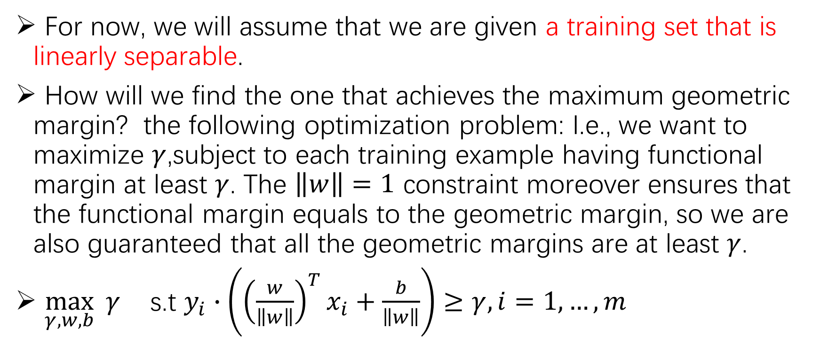
The optimal margin classifier
For now, we will assume that we are given a training set that is linearly separable.
How will we find the one that achieves the maximum geometric margin? the following optimization problem: I.e., we want to maximize $γ$,subject to each training example having functional margin at least $γ$. The $\left\|w\right\|=1$ constraint moreover ensures that the functional margin equals to the geometric margin, so we are also guaranteed that all the geometric margins are at least $γ$.
$\max_{γ,w,b}{ γ}$ s.t $y_{i}∙\left({\left(\frac{w}{\left\|w\right\|}\right)}^{T}x_{i}+\frac{b}{\left\|w\right\|}\right)≥γ, i=1,…,m$

Slide 19

The optimal margin classifier
For now, we will assume that we are given a training set that is linearly separable.
How will we find the one that achieves the maximum geometric margin? the following optimization problem: I.e., we want to maximize $γ$,subject to each training example having functional margin at least $γ$. The $\left\|w\right\|=1$ constraint moreover ensures that the functional margin equals to the geometric margin, so we are also guaranteed that all the geometric margins are at least $γ$.
$\max_{γ,w,b}{ γ}$ s.t $y_{i}∙\left(w^{T}x+b\right)∙\frac{1}{\left\|w\right\|}≥γ, i=1,…,m$

Slide 20
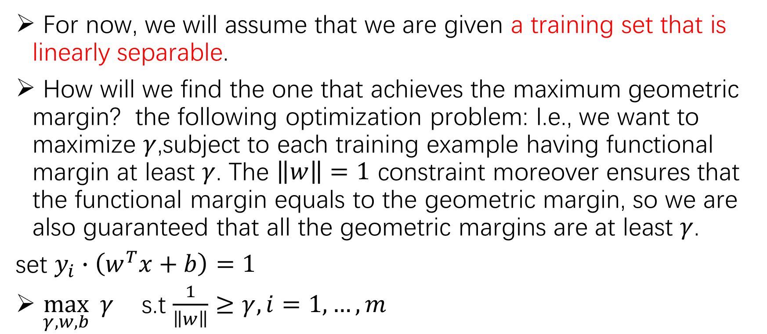
The optimal margin classifier
For now, we will assume that we are given a training set that is linearly separable.
How will we find the one that achieves the maximum geometric margin? the following optimization problem: I.e., we want to maximize $γ$,subject to each training example having functional margin at least $γ$. The $\left\|w\right\|=1$ constraint moreover ensures that the functional margin equals to the geometric margin, so we are also guaranteed that all the geometric margins are at least $γ$.
set $y_{i}∙\left(w^{T}x+b\right)=1$
$\max_{γ,w,b}{ γ}$ s.t $\frac{1}{\left\|w\right\|}≥γ, i=1,…,m$

Slide 21
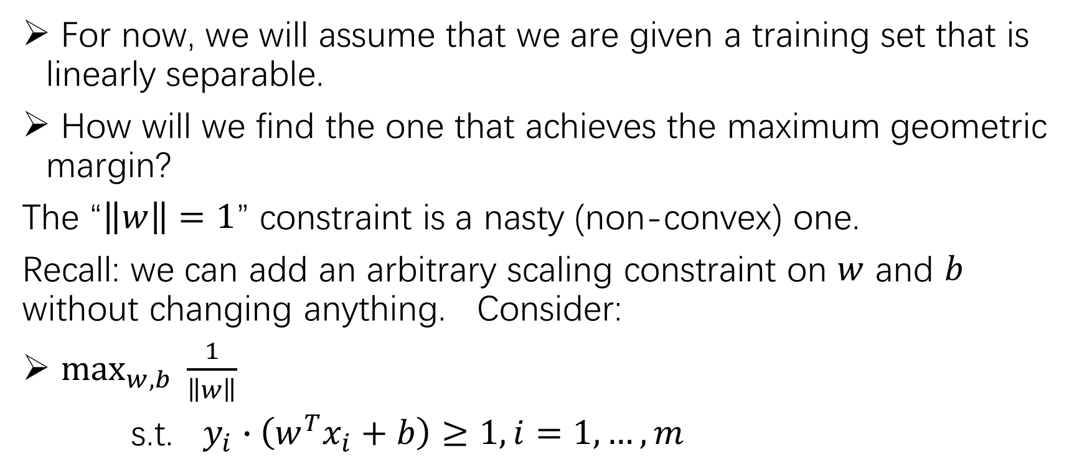
The optimal margin classifier
For now, we will assume that we are given a training set that is linearly separable.
How will we find the one that achieves the maximum geometric margin?
The “$\left\|w\right\|=1$” constraint is a nasty (non-convex) one.
Recall: we can add an arbitrary scaling constraint on $w$ and $b$ without changing anything. Consider:
$\max_{w,b}{ \frac{1}{\left\|w\right\|}}$
s.t. $y_{i}∙\left(w^{T}x_{i}+b\right)≥1, i=1,…,m$

Slide 22
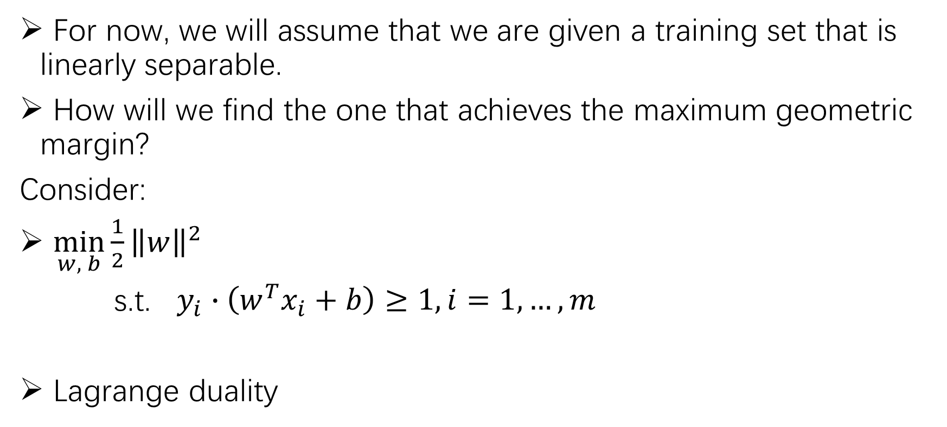
The optimal margin classifier
For now, we will assume that we are given a training set that is linearly separable.
How will we find the one that achieves the maximum geometric margin?
Consider:
$\min_{w, b}{\frac{1}{2}{\left\|w\right\|}^{2}}$
s.t. $y_{i}∙\left(w^{T}x_{i}+b\right)≥1, i=1,…,m$
Lagrange duality

Slide 23
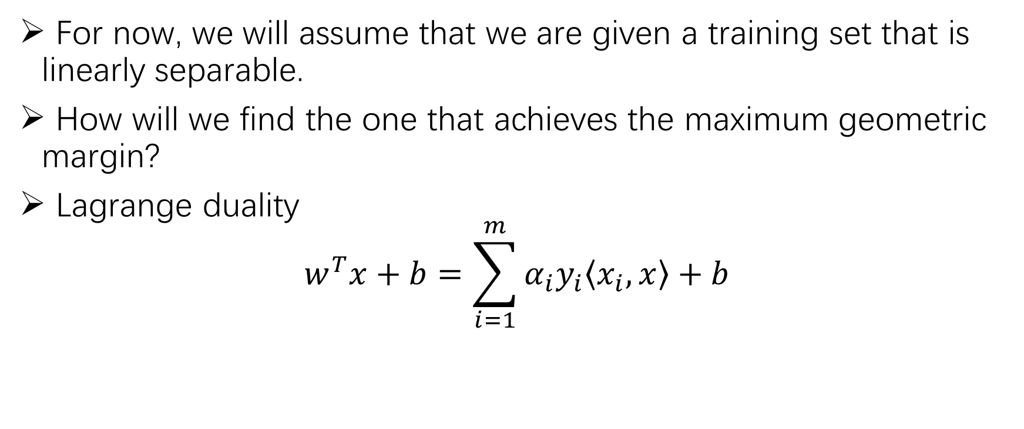
The optimal margin classifier
For now, we will assume that we are given a training set that is linearly separable.
How will we find the one that achieves the maximum geometric margin?
Lagrange duality
$$w^{T}x+b=\sum_{i=1}^{m}{α_{i}y_{i}\left\langle x_{i}, x\right\rangle +b}$$

Slide 24
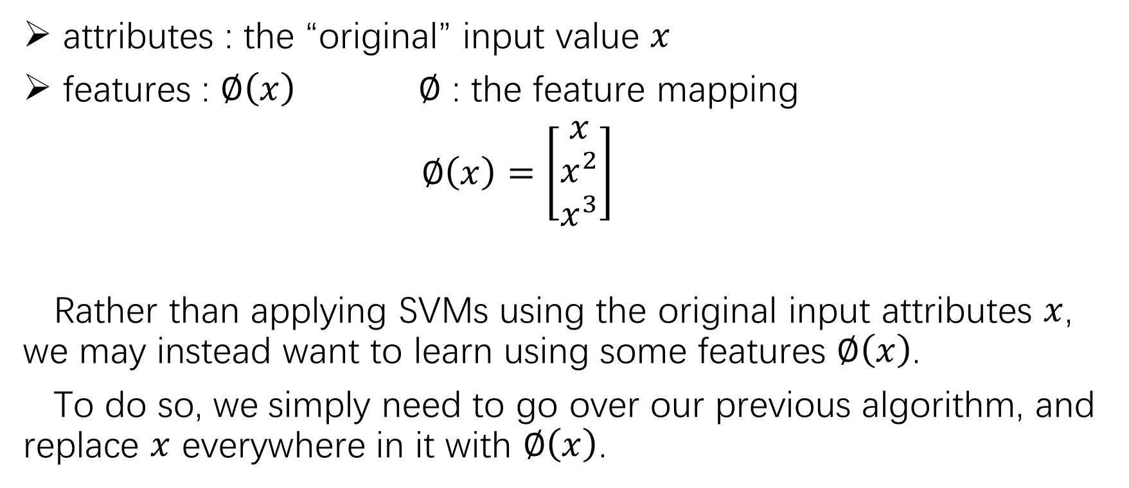
Kernels
attributes : the “original” input value $x$
features : $∅\left(x\right)$ $∅$ : the feature mapping
$∅\left(x\right)=\left[\begin{matrix}x \\ x^{2} \\ x^{3}\end{matrix}\right]$
Rather than applying SVMs using the original input attributes $x$, we may instead want to learn using some features $∅\left(x\right)$.
To do so, we simply need to go over our previous algorithm, and replace $x$ everywhere in it with $∅\left(x\right)$.

Slide 25
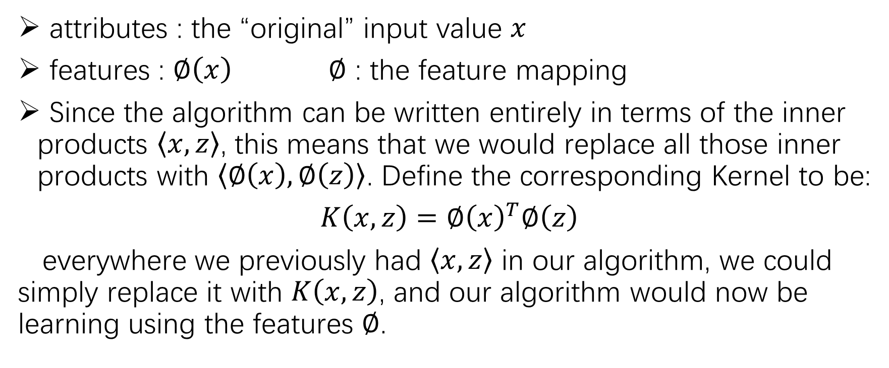
Kernels
attributes : the “original” input value $x$
features : $∅\left(x\right)$ $∅$ : the feature mapping
Since the algorithm can be written entirely in terms of the inner products $\left\langle x,z\right\rangle$, this means that we would replace all those inner products with $\left\langle ∅\left(x\right),∅\left(z\right)\right\rangle$. Define the corresponding Kernel to be:
$K\left(x, z\right)={∅\left(x\right)}^{T}∅\left(z\right)$
everywhere we previously had $\left\langle x,z\right\rangle$ in our algorithm, we could simply replace it with $K\left(x, z\right)$, and our algorithm would now be learning using the features $∅$.

Slide 26
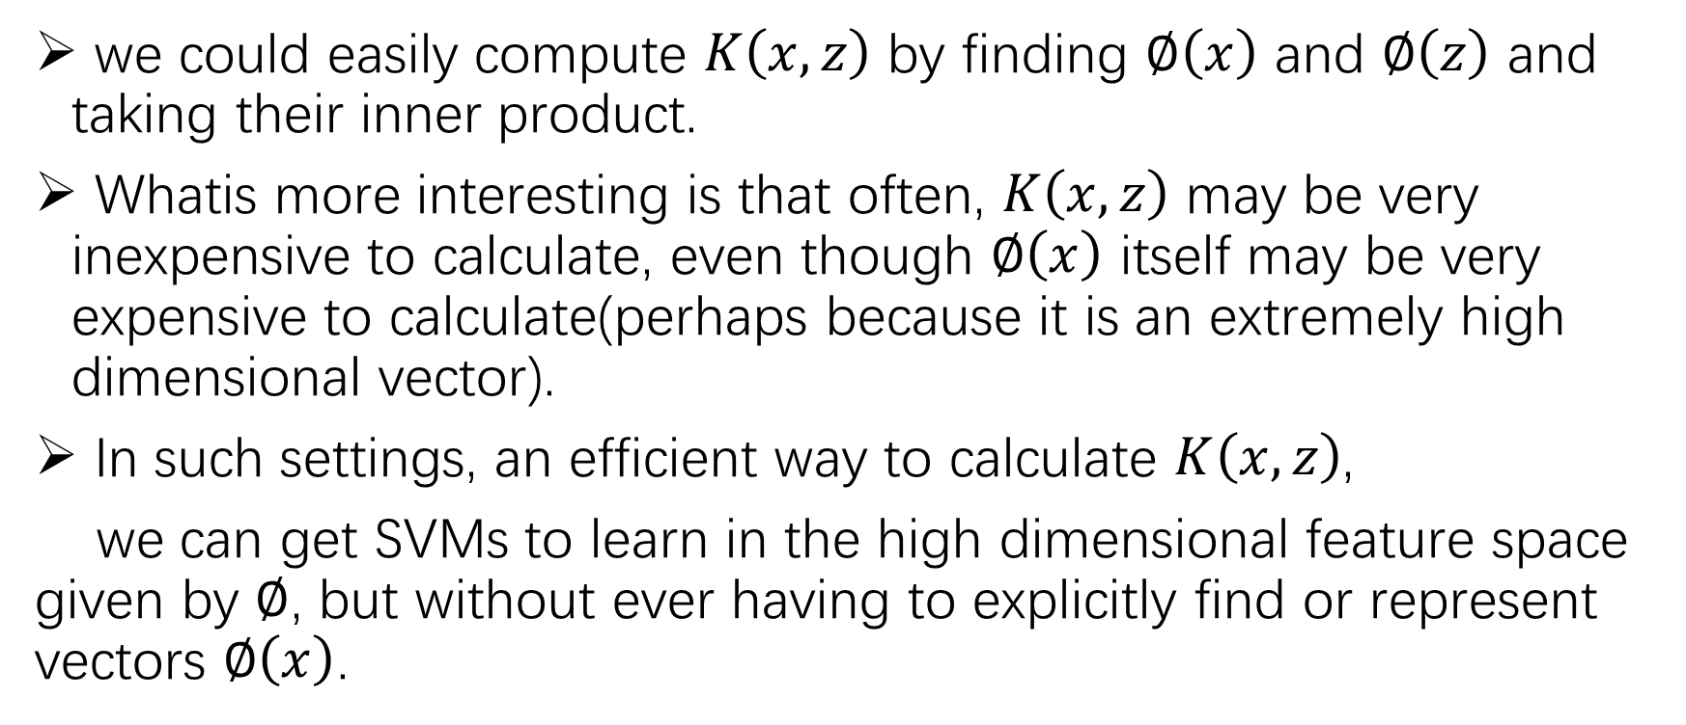
Kernels
we could easily compute $K\left(x, z\right)$ by finding $∅\left(x\right)$ and $∅\left(z\right)$ and taking their inner product.
Whatis more interesting is that often, $K\left(x, z\right)$ may be very inexpensive to calculate, even though $∅\left(x\right)$ itself may be very expensive to calculate(perhaps because it is an extremely high dimensional vector).
In such settings, an efficient way to calculate $K\left(x, z\right)$,
we can get SVMs to learn in the high dimensional feature space given by $∅$, but without ever having to explicitly find or represent vectors $∅\left(x\right)$.

Slide 27
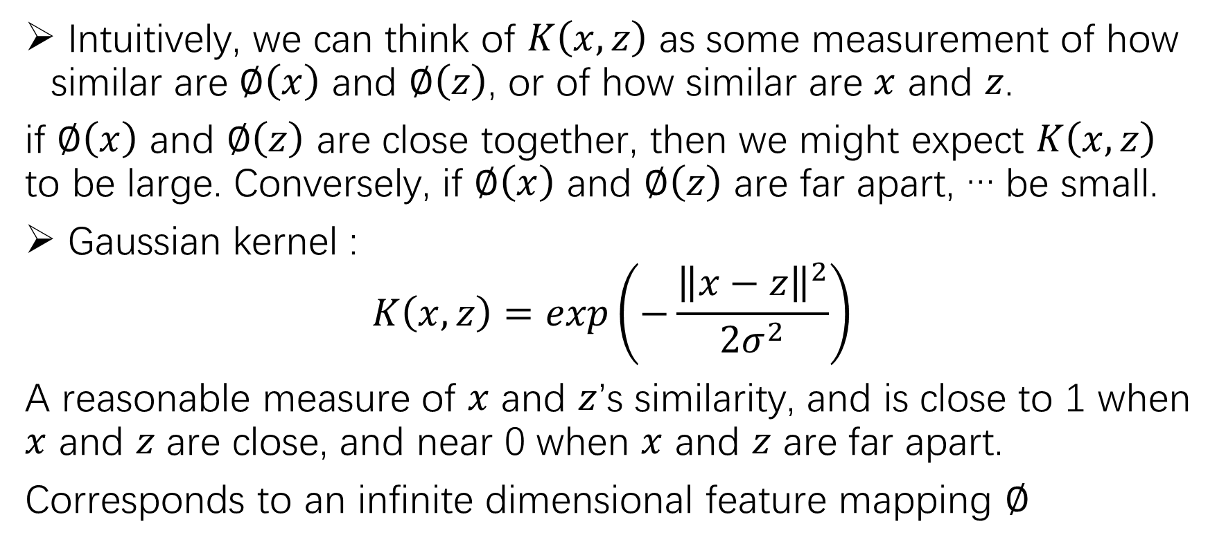
Kernels
Intuitively, we can think of $K\left(x, z\right)$ as some measurement of how similar are $∅\left(x\right)$ and $∅\left(z\right)$, or of how similar are $x$ and $z$.
if $∅\left(x\right)$ and $∅\left(z\right)$ are close together, then we might expect $K\left(x, z\right)$ to be large. Conversely, if $∅\left(x\right)$ and $∅\left(z\right)$ are far apart, … be small.
Gaussian kernel :
$$K\left(x, z\right)=exp\left(−\frac{{\left\|x−z\right\|}^{2}}{2σ^{2}}\right)$$
A reasonable measure of $x$ and $z$’s similarity, and is close to 1 when $x$ and $z$ are close, and near 0 when $x$ and $z$ are far apart.
Corresponds to an infinite dimensional feature mapping $∅$

Slide 28
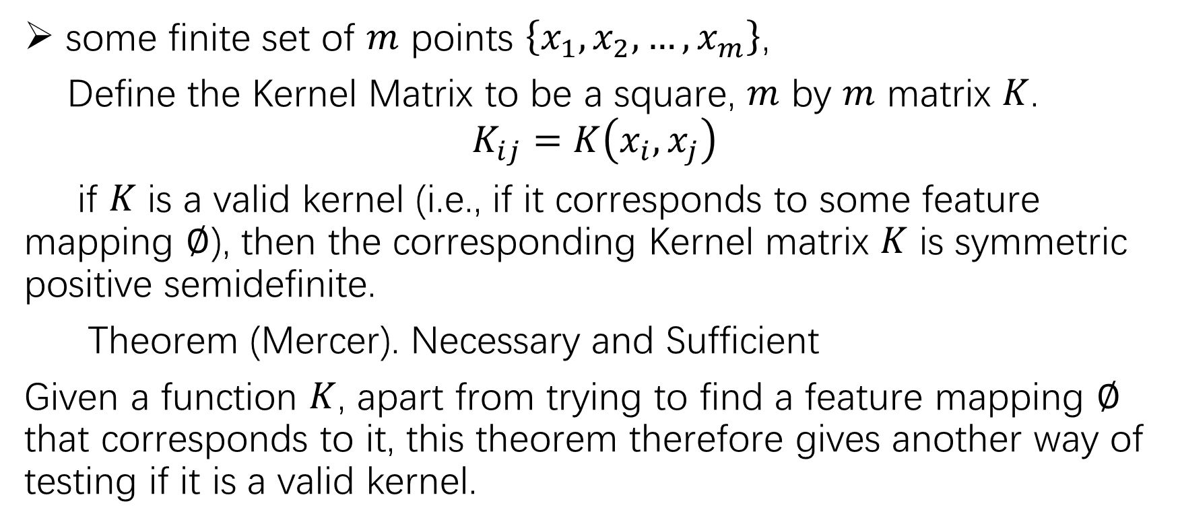
Kernels
some finite set of $m$ points $\left\{x_{1},x_{2},…,x_{m}\right\}$,
Define the Kernel Matrix to be a square, $m$ by $m$ matrix $K$.
$$K_{ij}=K\left(x_{i},x_{j}\right)$$
if $K$ is a valid kernel (i.e., if it corresponds to some feature mapping $∅$), then the corresponding Kernel matrix $K$ is symmetric positive semidefinite.
Theorem (Mercer). Necessary and Sufficient
Given a function $K$, apart from trying to find a feature mapping $∅$ that corresponds to it, this theorem therefore gives another way of testing if it is a valid kernel.

Slide 29
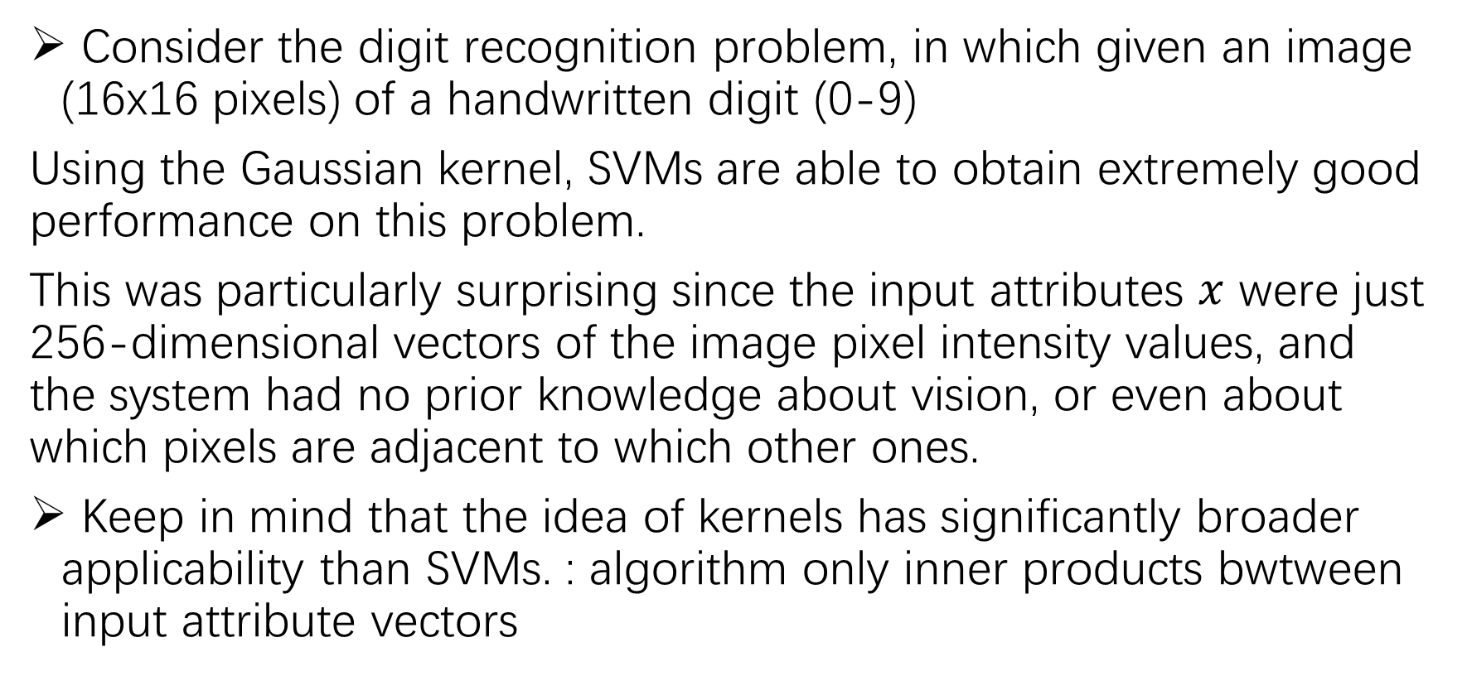
Kernels
Consider the digit recognition problem, in which given an image (16x16 pixels) of a handwritten digit (0-9)
Using the Gaussian kernel, SVMs are able to obtain extremely good performance on this problem.
This was particularly surprising since the input attributes $x$ were just 256-dimensional vectors of the image pixel intensity values, and the system had no prior knowledge about vision, or even about which pixels are adjacent to which other ones.
Keep in mind that the idea of kernels has significantly broader applicability than SVMs. : algorithm only inner products bwtween input attribute vectors

Slide 30
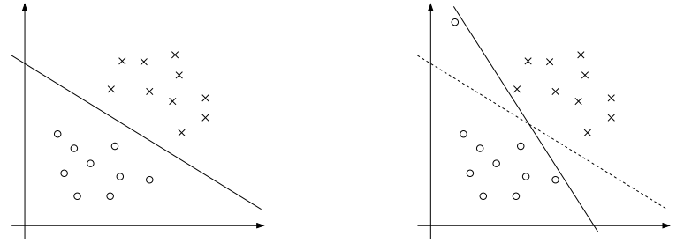
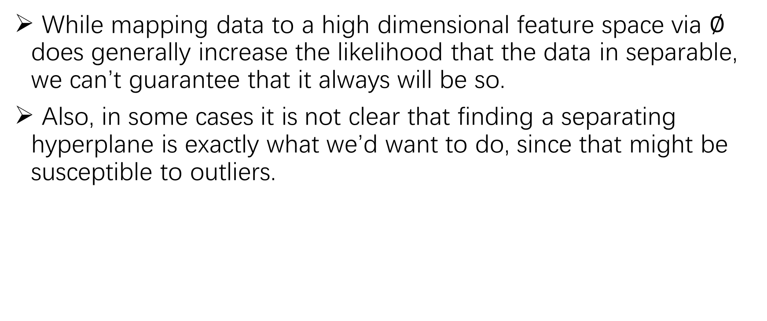
Regularization and the non-separable case
While mapping data to a high dimensional feature space via $∅$ does generally increase the likelihood that the data in separable, we can’t guarantee that it always will be so.
Also, in some cases it is not clear that finding a separating hyperplane is exactly what we’d want to do, since that might be susceptible to outliers.

Slide 31
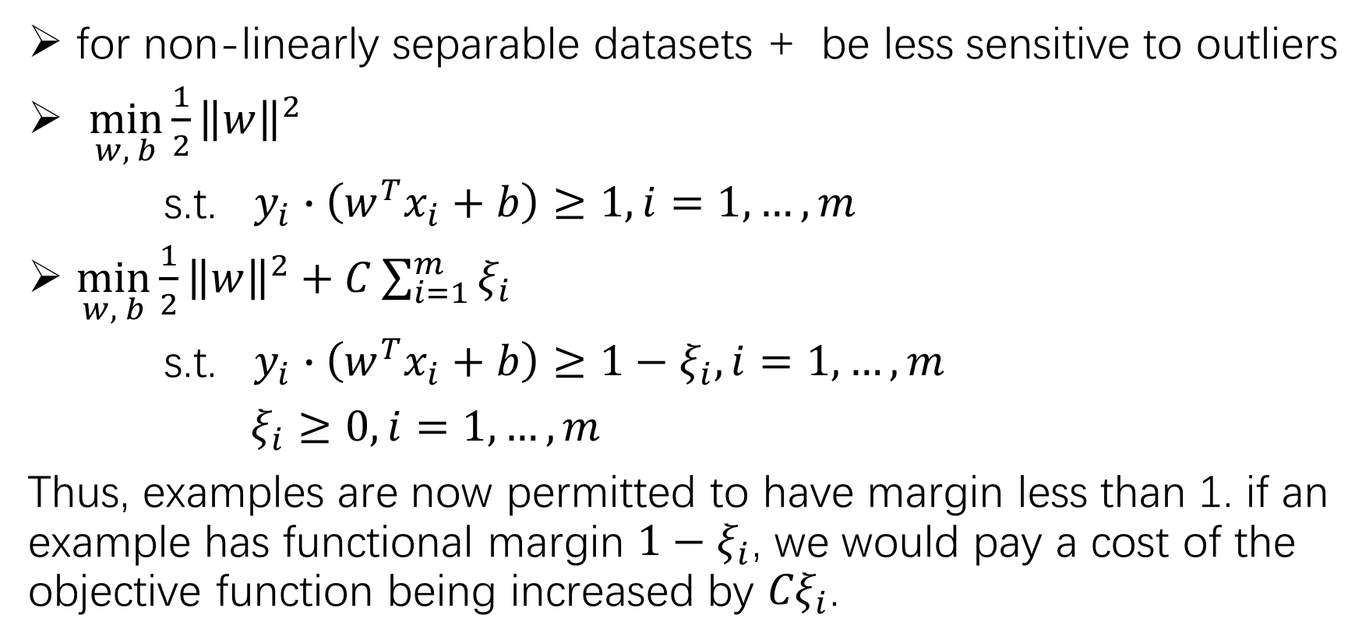
Regularization and the non-separable case
for non-linearly separable datasets + be less sensitive to outliers
$\min_{w, b}{\frac{1}{2}{\left\|w\right\|}^{2}}$
s.t. $y_{i}∙\left(w^{T}x_{i}+b\right)≥1, i=1,…,m$
$\min_{w, b}{\frac{1}{2}{\left\|w\right\|}^{2}+C\sum_{i=1}^{m}{ξ_{i}}}$
s.t. $y_{i}∙\left(w^{T}x_{i}+b\right)≥1−ξ_{i}, i=1,…,m$
$ξ_{i}≥0, i=1,…,m$
Thus, examples are now permitted to have margin less than 1. if an example has functional margin ${1−ξ}_{i}$, we would pay a cost of the objective function being increased by ${Cξ}_{i}$.

Slide 32

The SMO algorithm
Coordinate Ascent
$W\left(α_{1},…,α_{i−1},α_{i},α_{i+1}, …,α_{m}\right)$
Loop until convergence: {
For $i=1,…,m,$ {
$α_{i}≔\arg{\max_{{\hat{α}}_{i}}{W\left(α_{1},…,α_{i−1},α_{i},α_{i+1}, …,α_{m}\right)}.}$
}
}

Slide 33
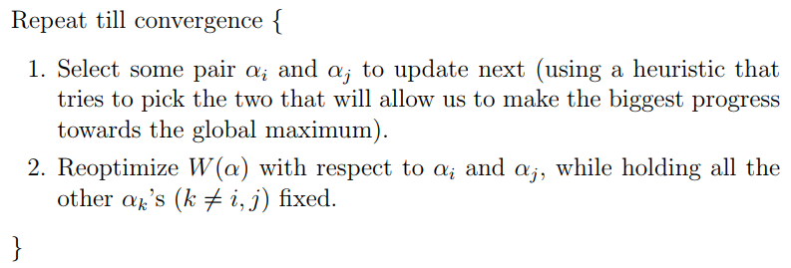
The SMO algorithm
the SMO algorithm
机器学习实战 libsvm

